Slide 1

WIRELESS CONNECTIVITY ISSUES
Project Guide :
DR. M Sesha Shayee,
Asst. Prof.
By,
GDVS SANDEEP
121812501026,
3/3 BCA.

Slide 2

Review 2.0

Slide 3

MATLAB is a proprietary multi-paradigm programming language and numeric computing environment developed by MathWorks. MATLAB allows matrix manipulations, plotting of functions and data, implementation of algorithms, creation of user interfaces, and interfacing with programs written in other languages. Wikipedia
Stable release: 9.9 (R2020b) / September 17, 2020; 5 months ago
Developer: MathWorks
Typing discipline: dynamic, weak
First appeared: late 1970s
Designed by: Cleve Moler
Paradigm: multi-paradigm: functional, imperative, procedural, object-oriented, array

Slide 4
MAT LAB:
MATLAB is composed to give access the to the framework programming is created by the LINPACK and the EISPACK ventures, which both speak to the edge programming for grid calculations. MATLAB was developed by the contributions from so many clients.

Slide 5

Cisco provides IT products and services across five major technology areas: Networking (including Ethernet, optical, wireless and mobility), Security, Collaboration (including voice, video, and data), Data Center, and the Internet of Things.
Industry: Networking hardware; Networking softwares,
Hosted Collaboration Solution (HCS)
Network Emergency Response
VoIP services ( Voice over Internet Protocol)
Area served: Worldwide

Slide 6
CISCO:
Cisco Security Agent :
The Cisco HIPS is Cisco Security Agent (CSA), which complements the Cisco NIPS, protecting the integrity of applications and operating systems. Malicious activity is blocked before damage is done by using behavior-based technology that monitors application behaviors. CSA protects against known and new/unknown attacks. Residing between the kernel and applications, CSA enables maximum application visibility with little impact to the performance and stability of the underlying operating system. A few of the numerous network security benefits CSA offers are as follows.

Slide 7
CISCO PACKET TRACER:
Bundle Tracer is the visual reenactment instrument by Cisco Systems that enables clients to make and organize topologies and the impersonate current PC systems. The product enables the clients to recreate the Cisco switches and the switches utilizing mimicked direction line interface. The product enables the clients to recreate the Cisco switches and switches utilizing a mimicked direction line interface. Beforehand under studies took the crack at a CCNA program could uninhibitedly downloads and utilizes the instruments for nothing out of pocket for instructive use only.

Slide 8
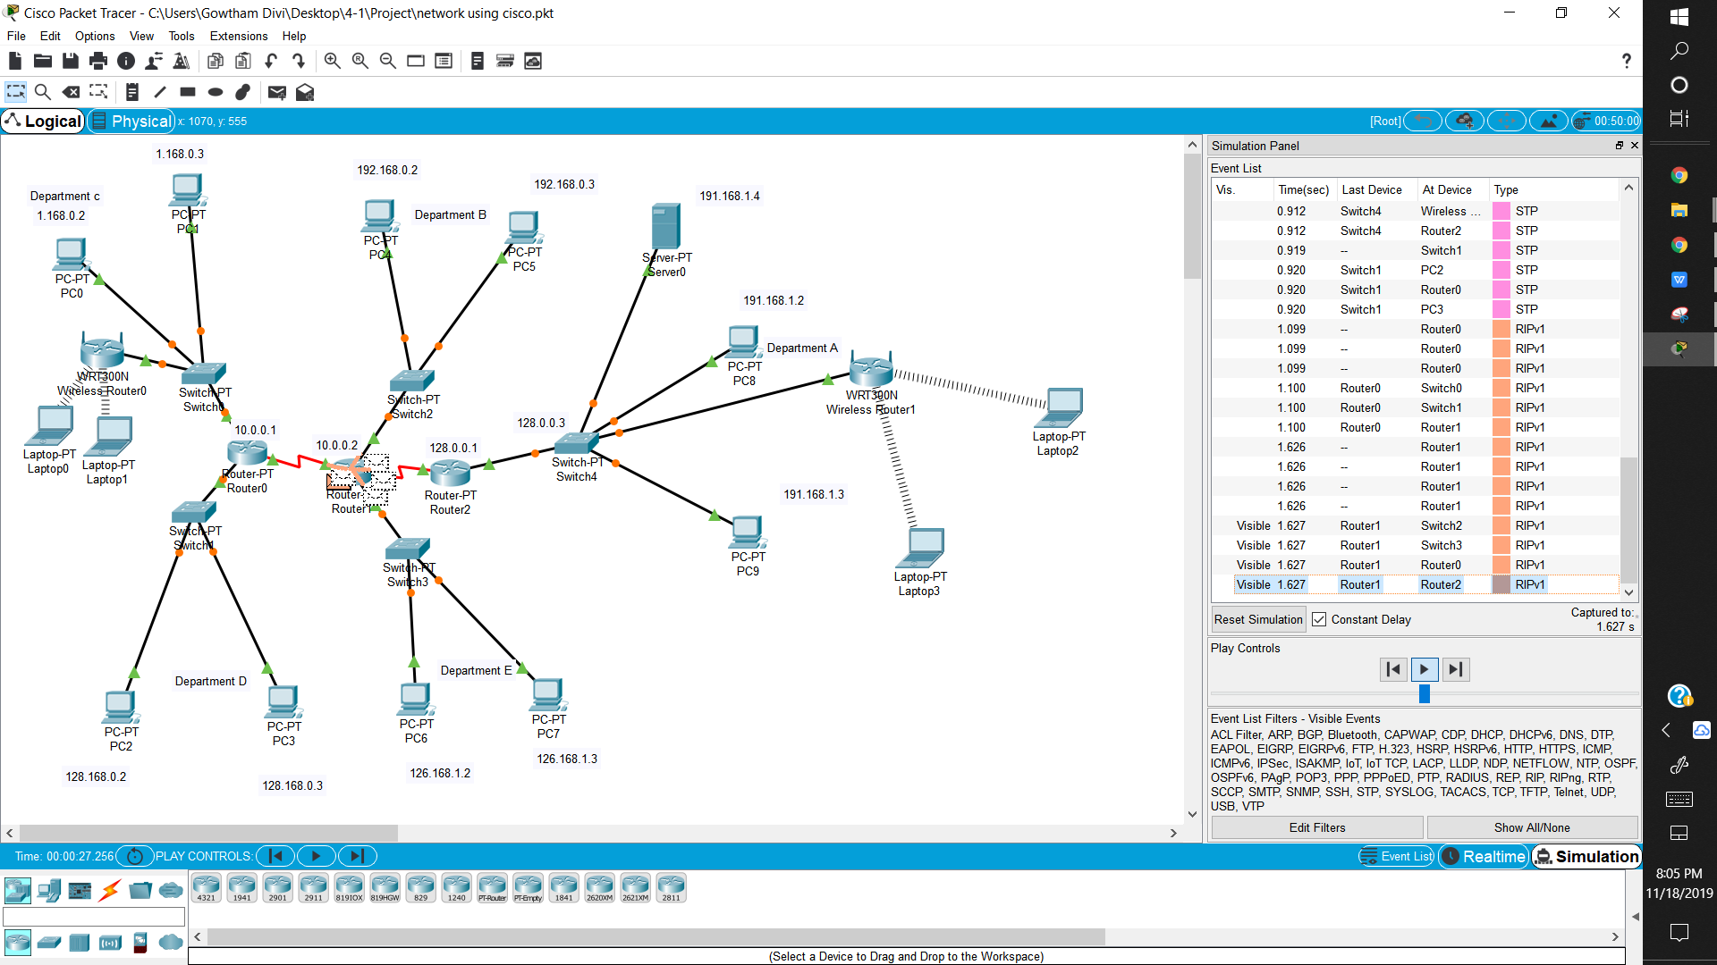

Slide 9
DISCUSSION OF RESULTS :
Describes implementation and experimental results.
:
Zero-update protection reduces emergency patching in response to vulnerability announcements, minimizing patch-related downtime and IT expenses.
Visibility and control of sensitive data protect against loss from both user actions and targeted malware.
Predefined compliance and acceptable use policies allow efficient management, reporting, and auditing of activities.
System is protected at all times, even when users are not connected to the corporate network or lack the latest patches. This is often referred to as “always vigilant” security

Slide 10
CLUSTERING:
The open-source grouping programming accessible here actualize the most regularly utilized bunching strategies for quality articulation information investigation. Bunching strategies can be utilized in a few different ways. Group 3.0 gives a Graphical User Interface to access to the bunching schedules. It is accessible for Windows, Mac OS X, and Linux/Unix. Python clients can get to the grouping schedules by utilizing Pycluster, which is an augmentation module to Python. Individuals that need to utilize the grouping calculations in their very own C, C++, or Fortran projects can download the source code of the C Clustering Library.

Slide 11
Introduction to Clustering:
It is basically a type of unsupervised learning method . An unsupervised learning method is a method in which we draw references from datasets consisting of input data without labeled responses. Generally, it is used as a process to find meaningful structure, explanatory underlying processes, generative features, and groupings inherent in a set of examples. Clustering is the task of dividing the population or data points into a number of groups such that data points in the same groups are more similar to other data points in the same group and dissimilar to the data points in other groups. It is basically a collection of objects on the basis of similarity and dissimilarity between them..
WHY CLUSTERING?

Slide 12
Why Clustering:
Clustering is very much important as it determines the intrinsic grouping among the unlabeled data present. There are no criteria for a good clustering. It depends on the user, what is the criteria they may use which satisfy their need. For instance, we could be interested in finding representatives for homogeneous groups (data reduction), in finding “natural clusters” and describe their unknown properties (“natural” data types), in finding useful and suitable groupings (“useful” data classes) or in finding unusual data objects (outlier detection). This algorithm must make some assumptions which constitute the similarity of points and each assumption make different and equally valid clusters.

Slide 13
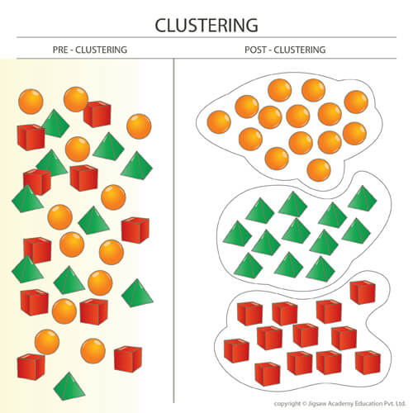

Slide 14
SOURCE CODE:
function LEACH()
n=200;
%Initial Energy
Eo=0.1;
xm=100;
ym=100;
%x and y Coordinates of the Sink
sink.x=1.5*xm;
sink.y=0.5*ym;
%Optimal Election Probability of a node
%to become cluster head
p=0.2;
%Eelec=Etx=Erx
ETX=50*0.000000001;
ERX=50*0.000000001;
%Transmit Amplifier types

Slide 15
Efs=10*0.000000000001;
Emp=0.0013*0.000000000001;
%Data Aggregation Energy
EDA=5*0.000000001;
%Values for Hetereogeneity
%Percentage of nodes than are advanced
m=0.5;
%\alpha
a=1;
%maximum number of rounds
%rmax=input('enter the number of iterations you want to run : ');
rmax=50;
%%%%%%%%%%%%%%%%%%%%%%%%% END OF PARAMETERS %%%%%%%%%%%%%%%%%%%%%%%%
%Computation of do
do=sqrt(Efs/Emp);
%Creation of the random Sensor Network
figure,
hold off;
for i=1:1:n
S(i).xd=rand(1,1)*xm;
XR(i)=S(i).xd;
S(i).yd=rand(1,1)*ym;
YR(i)=S(i).yd;
S(i).G=0;
%initially there are no cluster heads only nodes
S(i).type='N';

Slide 16
temp_rnd0=i;
%Random Election of Normal Nodes
if (temp_rnd0>=m*n+1)
S(i).E=Eo;
S(i).ENERGY=0;
plot(S(i).xd,S(i).yd,'o-r');
hold on;
end
%Random Election of Advanced Nodes
if (temp_rnd0<m*n+1)
S(i).E=Eo*(1+a);
S(i).ENERGY=1;
plot(S(i).xd,S(i).yd,'+');
hold on;
end
end
S(n+1).xd=sink.x;
S(n+1).yd=sink.y;
plot(S(n+1).xd,S(n+1).yd,'o', 'MarkerSize', 12, 'MarkerFaceColor', 'r');
figure(1);
% figure(1)
% plot(o1,o2,'^','LineWidth',1, 'MarkerEdgeColor','k', 'MarkerFaceColor','y', 'MarkerSize',12);
% hold on
%First Iteration
%counter for CHs
countCHs=0;
%counter for CHs per round
rcountCHs=0;
cluster=1;

Slide 17
countCHs;
rcountCHs=rcountCHs+countCHs;
flag_first_dead=0;
for r=0:1:rmax
r;
%Operation for epoch
if(mod(r, round(1/p) )==0)
for i=1:1:n
S(i).G=0;
S(i).cl=0;
end
end
hold off;
%Number of dead nodes
dead=0;
%Number of dead Advanced Nodes
dead_a=0;
%Number of dead Normal Nodes
dead_n=0;
%counter for bit transmitted to Bases Station and to Cluster Heads
packets_TO_BS=0;
packets_TO_CH=0;
%counter for bit transmitted to Bases Station and to Cluster Heads
%per round
PACKETS_TO_CH(r+1)=0;
PACKETS_TO_BS(r+1)=0;

Slide 18
figure(1);
for i=1:1:n
%checking if there is a dead node
if (S(i).E<=0)
plot(S(i).xd,S(i).yd,'^','LineWidth',1, 'MarkerEdgeColor','k', 'MarkerFaceColor','y', 'MarkerSize',8);
dead=dead+1;
if(S(i).ENERGY==1)
dead_a=dead_a+1;
end
if(S(i).ENERGY==0)
dead_n=dead_n+1;
end
hold on;
end
if S(i).E>0
S(i).type='N';
if (S(i).ENERGY==0)
plot(S(i).xd,S(i).yd,'o','LineWidth',1, 'MarkerEdgeColor','k', 'MarkerFaceColor','g', 'MarkerSize',8);
end
if (S(i).ENERGY==1)
plot(S(i).xd,S(i).yd,'+','LineWidth',3, 'MarkerEdgeColor','k', 'MarkerFaceColor','r', 'MarkerSize',8);
end
hold on;
end
end

Slide 19
plot(S(n+1).xd,S(n+1).yd,'x','LineWidth',1, 'MarkerEdgeColor','k', 'MarkerFaceColor','r', 'MarkerSize',8);
STATISTICS(r+1).DEAD=dead;
DEAD(r+1)=dead;
DEAD_N(r+1)=dead_n;
DEAD_A(r+1)=dead_a;
% plot(S(n+1).xd,S(n+1).yd,'o', 'MarkerSize', 12, 'MarkerFaceColor', 'r');
% plot(S(n+1).xd,S(n+1).yd,'x','LineWidth',1, 'MarkerEdgeColor','k', 'MarkerFaceColor','r', 'MarkerSize',8);
%When the first node dies
if (dead==1)
if(flag_first_dead==0)
first_dead=r;
flag_first_dead=1;
end
end
countCHs=0;
cluster=1;
for i=1:1:n
if(S(i).E>0)
temp_rand=rand;
if ( (S(i).G)<=0)
%Election of Cluster Heads
if(temp_rand<= (p/(1-p*mod(r,round(1/p)))))
countCHs=countCHs+1;
packets_TO_BS=packets_TO_BS+1;
PACKETS_TO_BS(r+1)=packets_TO_BS;

Slide 20
S(i).type='C';
S(i).G=round(1/p)-1;
C(cluster).xd=S(i).xd;
C(cluster).yd=S(i).yd;
plot(S(i).xd,S(i).yd,'k*');
distance=sqrt( (S(i).xd-(S(n+1).xd) )^2 + (S(i).yd-(S(n+1).yd) )^2 );
C(cluster).distance=distance;
C(cluster).id=i;
X(cluster)=S(i).xd;
Y(cluster)=S(i).yd;
cluster=cluster+1;
%Calculation of Energy dissipated
distance;
if (distance>do)
S(i).E=S(i).E- ( (ETX+EDA)*(4000) + Emp*4000*( distance*distance*distance*distance ));
%S(i).E=S(i).E- ( (ETX+EDA)*(4000) + Emp*4000*( distance*distance*distance*distance ));
end
if (distance<=do)
S(i).E=S(i).E- ( (ETX+EDA)*(4000) + Efs*4000*( distance * distance ));
%S(i).E=S(i).E- ( (ETX+EDA)*(4000) + Efs*4000*( distance * distance ));
end
Energy_disp(r+1) = S(i).E;
end
end
end
end

Slide 21
STATISTICS(r+1).CLUSTERHEADS=cluster-1;
CLUSTERHS(r+1)=cluster-1;
%Election of Associated Cluster Head for Normal Nodes
for i=1:1:n
if ( S(i).type=='N' && S(i).E>0 )
if(cluster-1>=1)
min_dis=sqrt( (S(i).xd-S(n+1).xd)^2 + (S(i).yd-S(n+1).yd)^2 );
min_dis_cluster=1;
for c=1:1:cluster-1
temp=min(min_dis,sqrt( (S(i).xd-C(c).xd)^2 + (S(i).yd-C(c).yd)^2 ) );
if ( temp<min_dis )
min_dis=temp;
min_dis_cluster=c;
end
end
%Energy dissipated by associated Cluster Head
min_dis;
if (min_dis>do)
S(i).E=S(i).E- ( ETX*(4000) + Emp*4000*( min_dis * min_dis * min_dis * min_dis));
end
if (min_dis<=do)
S(i).E=S(i).E- ( ETX*(4000) + Efs*4000*( min_dis * min_dis));
end
%Energy dissipated
if(min_dis>0)
distance=sqrt( (S(C(min_dis_cluster).id).xd-(S(n+1).xd) )^2 + (S(C(min_dis_cluster).id).yd-(S(n+1).yd) )^2 );
S(C(min_dis_cluster).id).E = S(C(min_dis_cluster).id).E- ( (ERX + EDA)*4000 );
if (distance>do)
S(C(min_dis_cluster).id).E=S(C(min_dis_cluster).id).E- ( (ETX+EDA)*(4000) + Emp*4000*( distance*distance*distance*distance ));
end

Slide 22
if (distance<=do)
S(C(min_dis_cluster).id).E=S(C(min_dis_cluster).id).E- ( (ETX+EDA)*(4000) + Efs*4000*( distance * distance ));
end
PACKETS_TO_CH(r+1)=n-dead-cluster+1;
end
S(i).min_dis=min_dis;
S(i).min_dis_cluster=min_dis_cluster;
end
end
end
hold on;
countCHs;
rcountCHs=rcountCHs+countCHs;
sum=0;
for i=1:1:n
if(S(i).E>0)
sum=sum+S(i).E;
end
end
avg=sum/n;
STATISTICS(r+1).AVG=avg;
sum;

Slide 23
%Code for Voronoi Cells
%Unfortynately if there is a small
%number of cells, Matlab's voronoi
%procedure has some problems
warning('OFF');
[vx,vy]=voronoi(X(:),Y(:));
plot(X,Y,'g+',vx,vy,'m-');
hold on;
voronoi(X,Y);
axis([10 xm 0 ym]);
end
msgbox('Leach Simulation completted....');
end

Slide 24
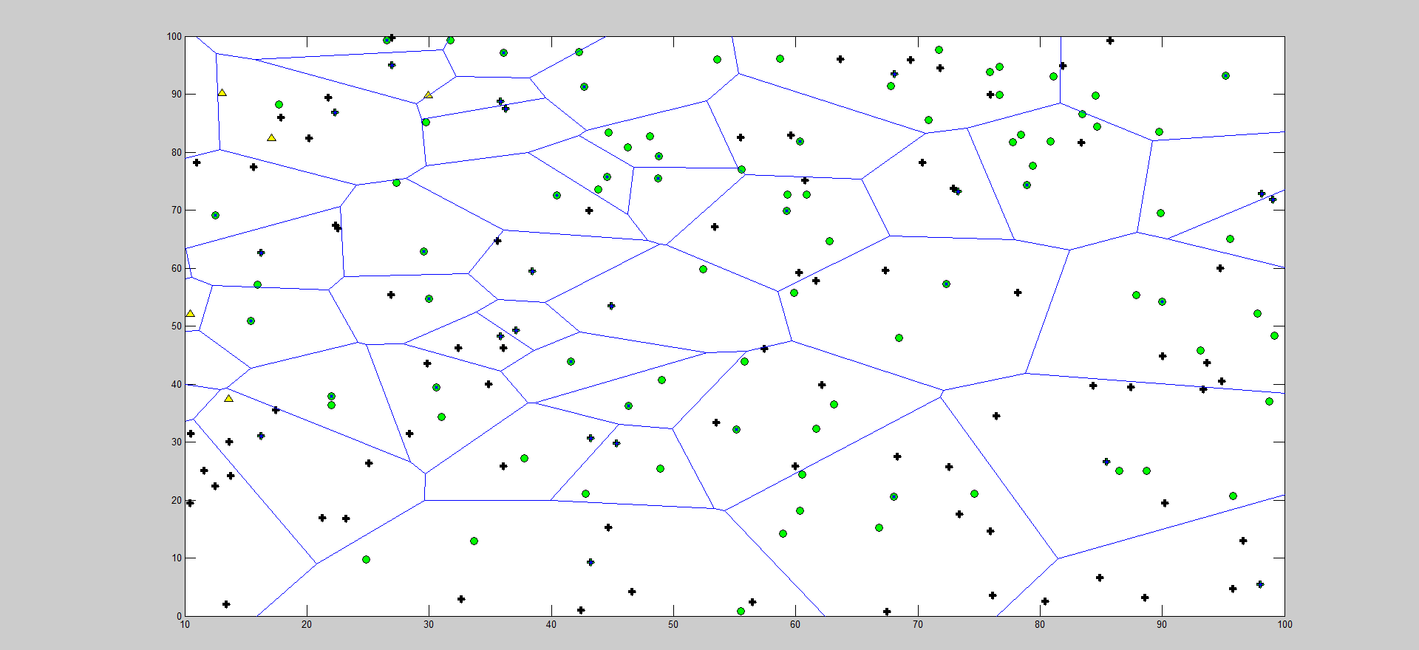
Output:

Slide 25
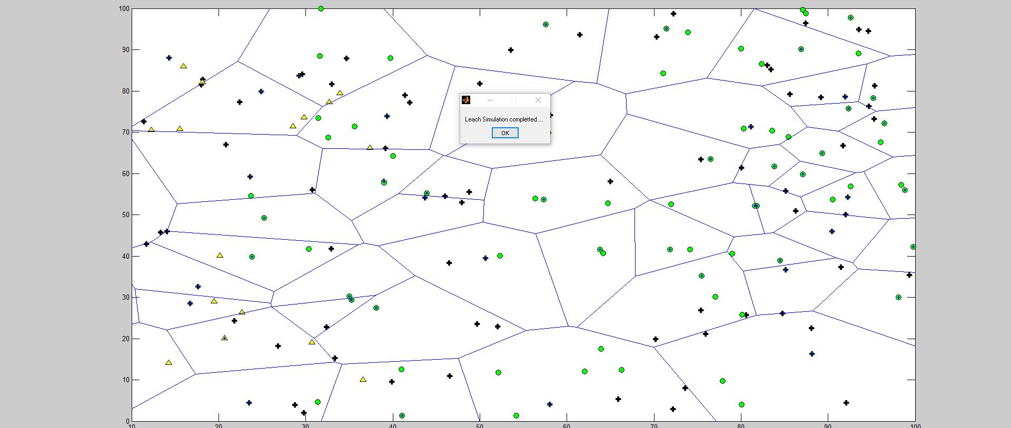
After Leach Simulation Completed :

Slide 26
Problem statement :
To overcome the problem an hybrid combination to improve the qos service is proposed in the research paper to improve the searching methodology, genetic algorithm is proposed and to improve the better quality in the transmission of packets, cooperative catching is proposed and this approach certainly proves worthier than the initial versions of reactive protocols.

Slide 27
Proposed solution :
We present a dynamic programming of the connectivity with coverage of clustered structure and its effect on routing in generalized Wireless Sensor Network (WSN)
The performance evaluation of the proposed schemes shows that availability of node, sensor node coverage and the connectivity were sufficiency enhanced to maximize network lifetime.

Slide 28
Plan of action:
We are going to implement software simulation model using matlab.
Using energy based routing protocol connectivity we intend to apply the model on wireless sensor network environment where the problem of coverage and connectivity becomes more complex.
By using the mature heuristic based methods in order to enhance the efficiency of method.

Slide 29
Conclusion :
The problem of optimal connectivity with coverage in general WSNs was addressed. The connected coverage problem is crucial in WSNs as sensitive applications of WSNs require high level of connectivity as well as cover-age. We proposed a method to schedule the sensor nodes such that only minimum number of sensor nodes will be active, satisfying connectivity and coverage requirement that leads to higher network lifetime. This method can be prominent applications where all the point in the field need not be monitored with the same proximity and when k-connectedness should exist within the nodes that are turned on. This will guarantee the correctness of the information collected and also to ensure the reachability of the information at other nodes including base station.

Slide 30
Reference papers :
[1]Wislab Wireless System Laboratory of Brno, Wislab, Brno,Czech Republic, 2017.
[2] J. Yick, B. Mukherjee, and D. Ghosal, ‘‘Wireless sensor network survey,’’ Comput. Netw., vol. 52, no. 12, pp. 2292–2330, Aug. 2008.
[3] J. Chen and X. Koutsoukos, ‘‘Survey on coverage problems in wire-cless ad hoc sensor networks,’’ in Proc. IEEE SouthEastCon, Mar. 2007,pp. 1–6.
[4] M. Chaudhary and A. K. Pujari, ‘‘Q-coverage problem in wireless
sensor networks,’’

Slide 31



